Slide 1
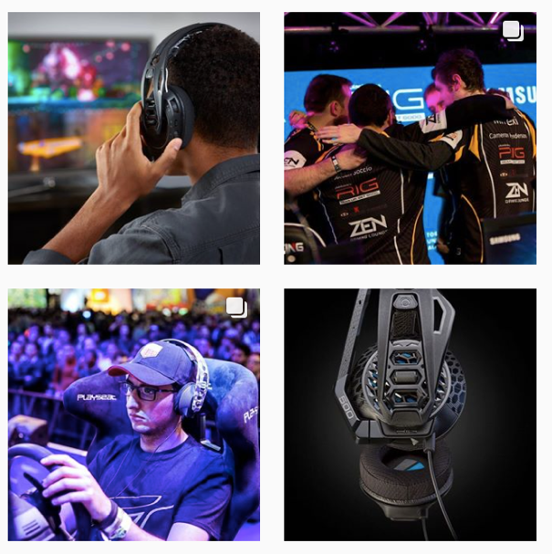
A CUSTOMER-CENTRIC APPROACH TO PRODUCT DEVELOPMENT
Tanguy Leborgne, VP & GM Consumer

Slide 2
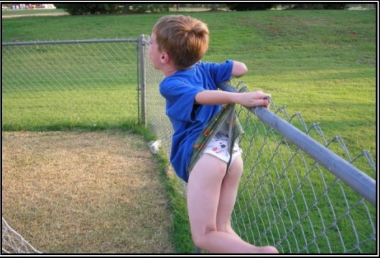
95% of products launched each year FAIL!

Slide 3
… Why Do Most New Products Fail?

Slide 4
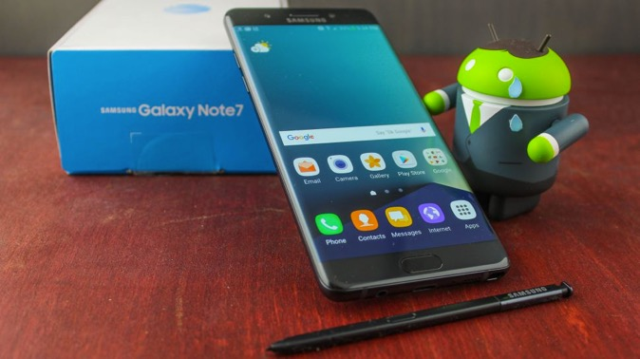
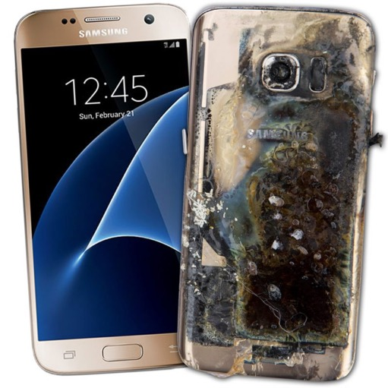
Flawed Processes…

Slide 5
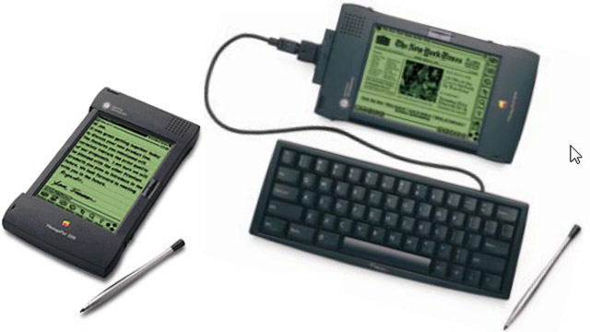
Bleeding edge, yet too many deficits…

Slide 6
Not Your Cup Of Tea…

Slide 7
Not your DNA and too Inside-Out…

Slide 8
JUST not REAL YET!

Slide 9
Failure To Adapt…

Slide 10
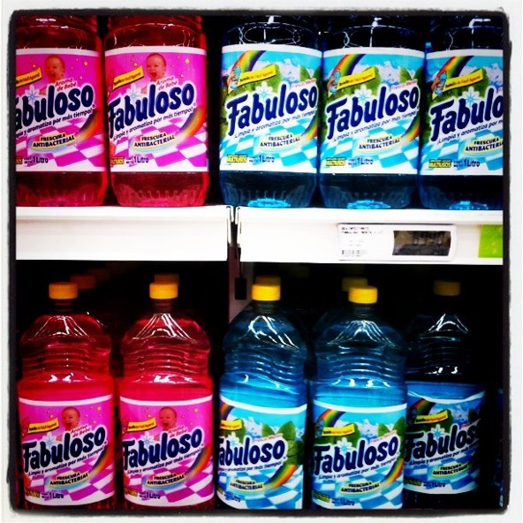
What do you think this product is for?
(Honestly!)
Kids Juice
Juice in general (kids or adults)
Soda
Hair Care
Cleaning Supplies

Slide 11
Misleading (Packaging) Design…

Slide 12
We’re Not Immune…

Slide 14
Facing Market Facts and Customer Reality

Slide 15
Identify and calibrate the Opportunity
Know your market
Study Competition
Understand Key Trends
Know Your Capabilities

Slide 16
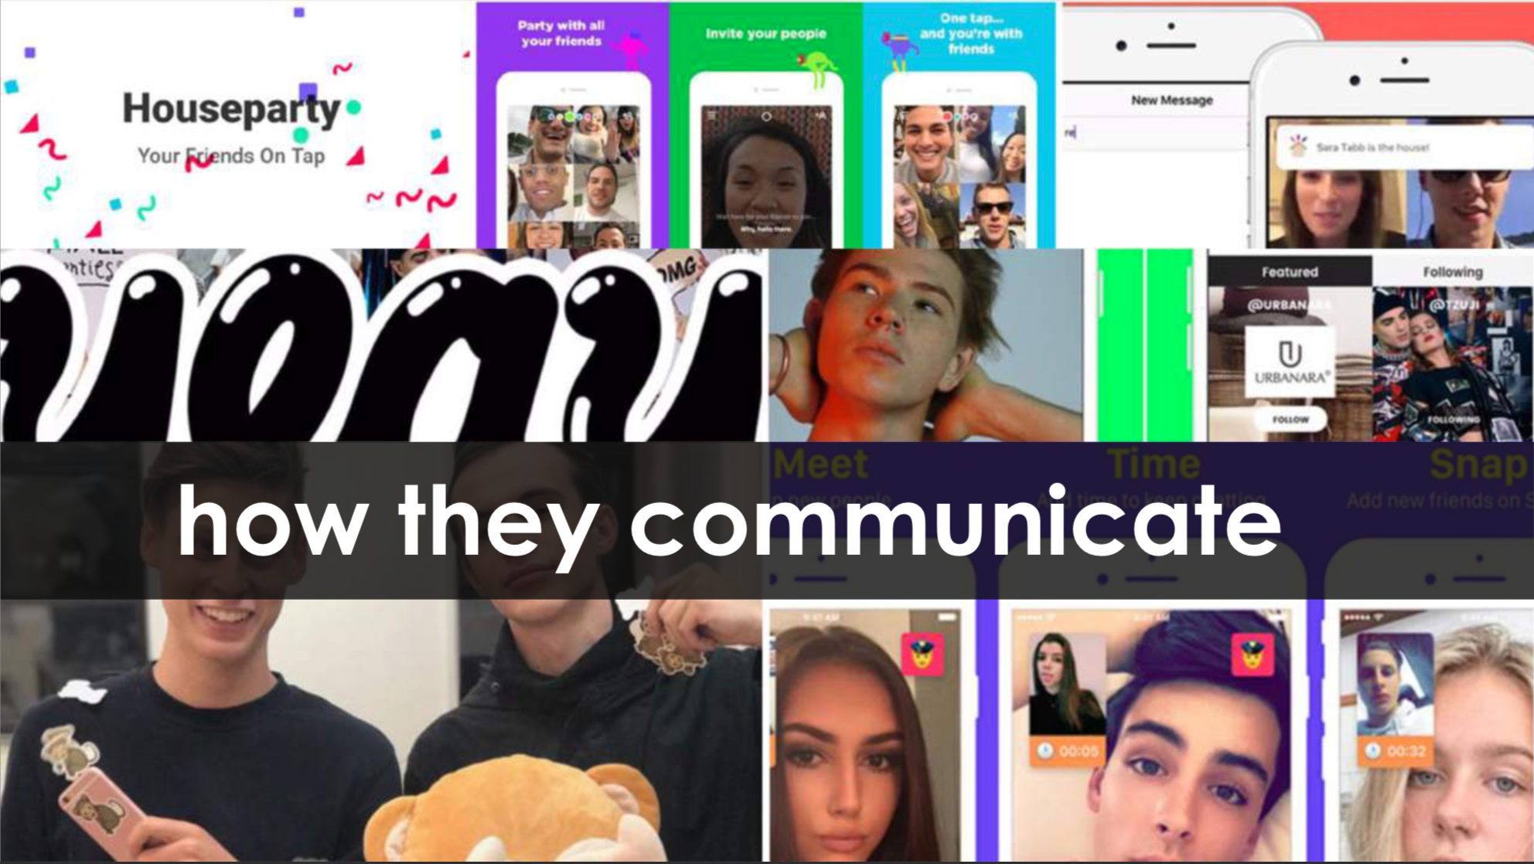
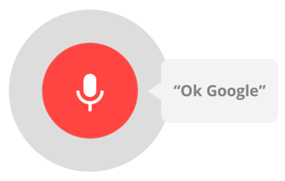
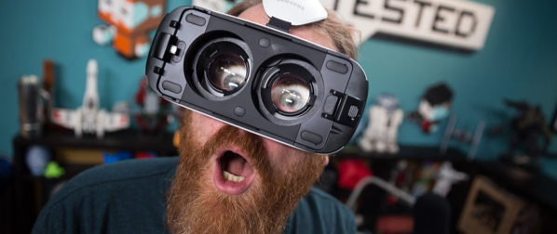
Example of Key Trends
VIRTUAL ASSISTANTS TURNING MAINSTREAM
GEN Z’s EXTREME MOBILE CENTRICITY
HUDDLE ROOMS A BYPRODUCT OF OPEN SPACES
VR BECOMING A REALITY

Slide 17
Build Utmost Intimacy With Your Target Audience

Slide 18
Identify BIG HAIRY PROBLEMS
The most painful
The most pervasive
The most urgent
The high $$ ones

Slide 19
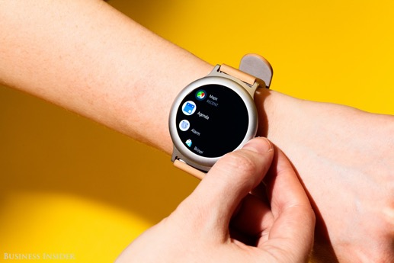
Get into their Minds…
Their Desires
Their Values
Their “Social Map”

Slide 20
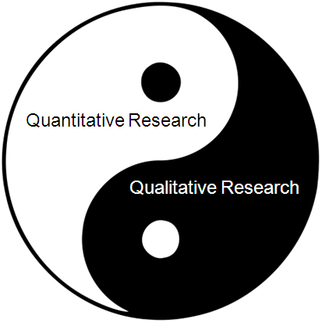
Research Helps Understand Your Audience Better
Close Ended
Numerical Analysis
Trends & correlations
Segment sizing
Open Ended
Help Dig Deeper
Address the “WHY’s”
Know values, environment

Slide 21
A Few Resources
Primary Research (online polls, online surveys)
Secondary Research (Internet sources, public and Educational Institutions)
1:1’s with channel
1:1 with influencers
1:1’s with target audience
Ethnographic observations
Consumer Reviews
Net Promoter Score

Slide 22
The Analysis
The Analysis…
…Turn Facts Into Actionable Insights

Slide 23
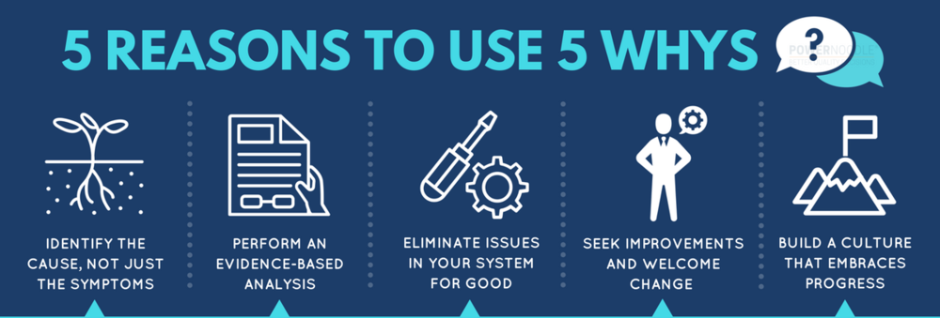
Obsess over Cause-and-Effect Analysis to the Top Requirements
?
The Analysis…
…Turn Facts Into Actionable Insights

Slide 24
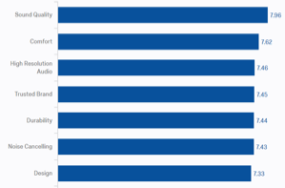
Creating Insight-Based Personas
COSMO
NAME: Marcus Modern
FROM: London, England
AGE: 34
WORK: MANAGER
INCOME: 100K
EDUCATION: MBA
MARRIED WITH 1 CHILD
SINGLE FAMILY HOME
PRIMARY LIFE PURSUITS
PERSONAL STYLE
EXERCISES 6 HRS WEEKLY
PHONE
CAR
LEISURE ACTIVITIES
I live where luxury and technology intersect. I seek products that enhance my life experiences and am highly design motivated in my purchases. I always know about the latest trends in technology.
LEARNS ABOUT NEW PRODUCTS
PRODUCT PROFILE
MUSICAL PREFERENCE
STREAMING SERVICES
SOCIAL
EQ
ACCURATE/FLAT
PLAYS MUSIC ON
HEADPHONE WEARING STYLE
PRIMARY HEADPHONE ATTRIBUTES
WHY?
SOUND
CLOSEST COMPETITIVE OPTION
WHY?
DESIGN
IN-EAR
BOSE SOUNDSPORT WIRELESS
149
OVER-EAR
BOSE QC35
349.95
SPENDING RANGE

Slide 25
Find Pace and Place…
Institutionalize market and customer feedback
Engage the different functions into “why” and “so what”

Slide 26
Example of Implementation: MoM Process (Meetings Of the Minds)
Cross-functional review of market insights
Product Mgt, Product Mktg, Engineering, Sales, Support
Regular pace (once a week, once a month)
Clear outcomes
No action - not for us
Need more research-validation
Ready for action

Slide 27
The Right Insights Lead To A Stronger Roadmap

Slide 28
Know Your Respective Roles…
Portfolio Strategy & Product Management
Focus on identifying and calibrating problems
Engineering & Development
Focus on solving problems
Marketing & Sales
Focus on articulating and delivering the story

Slide 29
In Summary…
Know intimately your target audience
Build products for your target audience
But remember, your market is NOT your target (market is much larger!)

Slide 30
Recap… Outside-In!
Forget “opinions”!
Focus on properly analyzed market facts
Relentlessly prioritize
Establish your happy pace
NIHITO!

Slide 31
WHY DO MOST PRODUCTS FAIL?
ATTRIBUTES OF BIG HAIRY PROBLEMS?
DIFFERENCE BETWEEN TARGET AND MARKET?
TELL ME MORE ABOUT QUALITATIVE RESEARCH!

Slide 32
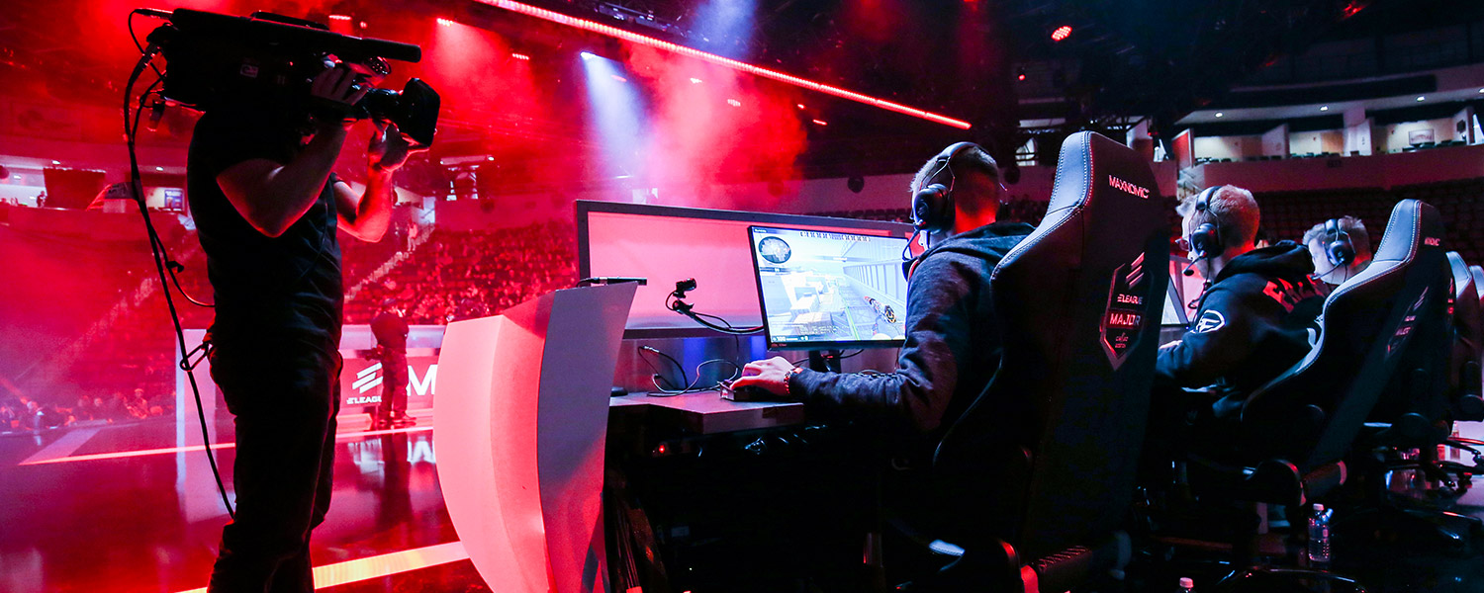
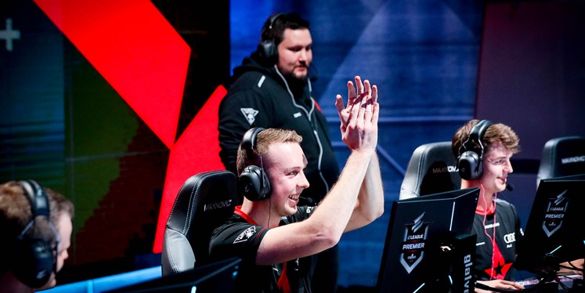
THANK YOU!

