Slide 1
Modernizing the Workforce Kailey Oppenheim TIM 101 1/17/2019

Slide 2
Agenda
Introduction
The business problem
Solving for efficiency
Use case: Onboarding a new employee
Implementation: Agile methodology
Q&A

Slide 3
Introduction

Slide 4
Kailey Oppenheim
kailey.oppenheim@accenture.com
Bio
Certifications
ITIL Foundation in IT Service Management (ITIL Foundations v3)
Project Management Professional (PMP)
ServiceNow Administrator
ServiceNow Implementation Specialist for IT Service Management, Human Resources, Customer Service
ServiceNow Trainer
ServiceNow Application Developer
Graduated from UCSC with a BS in Information Systems Management (now TIM)
ISMA Co-President (2008-2009)
2010
Started a new job as a ServiceNow Business Analyst Consultant at Navigis > Cloud Sherpas > Accenture
2014+
2009
Internship with Plantronics, transitioned to a Full Time role
2012
Started a new role working for Macys.com
Current role: Senior Manager at Accenture
2013

Slide 5
My Career Journey
Help Desk Intern
Business Analyst
Manager
Senior Business Analyst
Senior Manager

Slide 6
My Role at Accenture
Senior Manager
Work with clients in various industries to identify opportunities for efficiency
Propose projects to the client, write the contract and statement of work (SOW), staff the delivery team, and oversee delivery of the work
Team Manager
Manage a team of 7 people
Advise and support career growth
Assign team members to projects

Slide 7
A Typical Work Day…
Working from home
On the road
Travel about 50%
Visit the client’s office and work with stakeholders
Schedule and facilitate meetings to ensure we are meeting their vision
Design a roadmap for future work
No commute ☺
Many meetings using VoIP (screen share, web cam, digital whiteboards)
Start the day when the client starts

Slide 8
What is Accenture?
A global consulting firm providing professional services to clients. This can include subject matter expertise, staff augmentation, or helping clients with innovative ideas to operate at the next level.
There are 400,000+ Accenture employees world wide!
SHAPES
Business Strategy
Technology
Strategy
TRANSFORMS
Management Consulting
Technology Consulting
DIGITIZES
Interactive
Mobility
Analytics
POWERS
Application
Services
Labs
Ecosystem
Alliances
OPERATES
As a Service
Business Process
Cloud
Security
Notes:
Accenture Strategy is where we shape our clients’ future… combining deep business insight with the understanding of how technology will impact industry and business models.
In Accenture Consulting, we transform, bringing together the very best of Accenture to help our clients transform their businesses to compete in today’s digital world.
In Accenture Digital, we digitize, enabling our clients to unleash the power of digital… by providing analytics, interactive marketing and mobility services to create new value.
Accenture Technology is where we power our clients’ businesses with “best in class” established and emerging technologies.
And Accenture Operations is where we operate business processes and infrastructure as a service on behalf of our clients.
We are the only company with the ability to combine and integrate these end-to-end capabilities—strategy, consulting, digital, technology and operations—in an industry context.

Slide 9
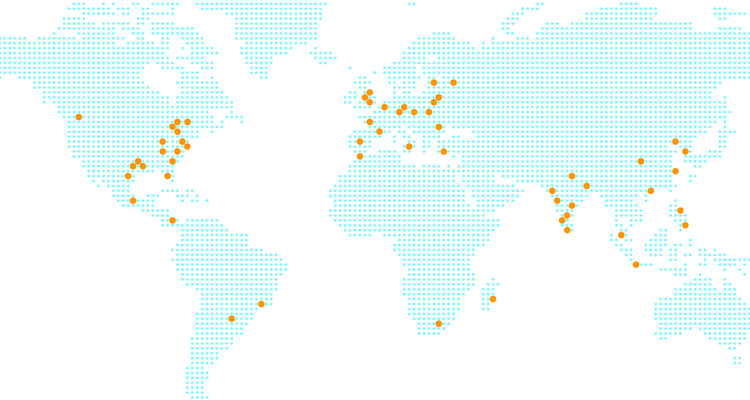
OUR GLOBAL DELIVERY NETWORK DELIVERS AT SPEED AND AT SCALE
More than 50 delivery centers across five continents, offering services in 39 languages
The largest and most diversified group of strategy, digital, technology and operations professionals in the world

Slide 10
The business problem

Slide 11
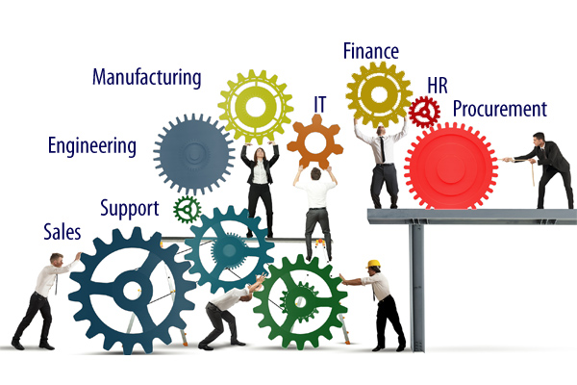
Enterprise Organization
There are many departments within an enterprise

Slide 12
Common business problems
Departmental
siloes
Manual
Processes
Redundancy
Offline
tools

Slide 13
Common business problems
Departmental
siloes
Manual
Processes
Redundancy
Offline
tools

Slide 14
Departmental Siloes
Departments are often using different technologies or tools
Processes aren’t defined to work seamlessly across the enterprise
Transferring work between departments is slow and inefficient

Slide 15
Common business problems
Departmental
siloes
Manual
Processes
Redundancy
Offline
tools

Slide 16
Manual processes
Manual processes
Entering data
Creating reports
Approving requests
Fulfilling requests
Lack of enterprise knowledge
No standards
No central repository
No FAQs or How to guides
Who owns the knowledge?

Slide 17
Common business problems
Departmental
siloes
Manual
Processes
Redundancy
Offline
tools

Slide 18
Redundancy
Entering the same data into two different systems AKA “Swivel Chair”
From an offline form into an online form
Two systems without an integration between them
Lack of documentation of communication between customer and service provider leads to repeated conversations

Slide 19
Common business problems
Departmental
siloes
Manual
Processes
Redundancy
Offline
tools

Slide 20
Tools hindering business productivity
Email
Paper forms
Offline or non-shared documents
Multiple enterprise applications

Slide 21
Poor customer/ user experience
Dissatisfied employees reduce productivity
Manual processes slow down the business
Evolution of “Shadow IT”
Dissatisfied end users

Slide 22
Solving for efficiency

Slide 23
One enterprise platform
SaaS, or Software as a Service, is a cloud solution that can provide businesses with an easy product to develop, maintain, and secure.
Having one platform across the enterprise allows transparency, efficiency, and standardization.

Slide 24
Accenture’s ServiceNoW Practice
…by the numbers
Global Strategic Partner
Gold Sales Partner
Gold Services Partner
Authorized Training Partner
We Are ServiceNow’s Largest Professional Services Partner
175+
Global 200 Customers
ServiceNow Global 2000 Customers Supported
1,850+
ServiceNow & ITSM Certifications
5,000+
ServiceNow Projects
2,250+
ServiceNow Skilled Resources Globally
1,200+
ServiceNow Initial Implementations
9.7
YTD CSAT
Calendar Year 2019
7,000+
Students Trained on ServiceNow
250 Classes delivered in 2019
1
Forrester ITSM Leader
Only Dedicated ServiceNow Services Partner in the Leader Wave
3x
ServiceNow Federal Partner of the Year
2
ServiceNow Store Apps Legal & Security
1
HfS Winners Circle, Blueprint for ServiceNow Service Assessment
6,380+
Share Downloads
Average 5-star rating

Slide 25
Accenture’s ServiceNow Practice
Continuously Investing in Growth
As a partner in the ecosystem for more than 10 years, we have continued to invest in growing our capabilities and partnership with ServiceNow.
2007
2011-2012
2013 - 2014
2015
2019
2019
Accenture co-authors ITIL Service Strategy book
Cloud Sherpas (Navigis) begins offering clients ServiceNow capabilities
Accenture builds formal ServiceNow offering
Accenture launches ServiceNow practice
Cloud Sherpas first ServiceNow Preferred Services Partner
Accenture and ServiceNow sign strategic alliance agreement
Accenture achieves ServiceNow global systems integrator status
Cloud Sherpas one of the first Master Services Partner
Accenture acquires Cloud Sherpas
ServiceNow Federal Partner of the Year (3x)
K15 Partner Award - Highest Partner CSAT
Cloud Sherpas named Leader by Forrester for ITSM Implementation Services
Accenture largest global ServiceNow Strategic Partner
Named Gold Partner – Sales, Services and Technology
Largest ACV Revenue Contributing Partner
Awarded Trainer of the Year
Awarded Most Partner Certifications
Acquired Nashco
Named Global Strategic Partner by ServiceNow
Top Sponsor of ServiceNow’s SKO & K17
Awarded Highest CSAT (EMEA)
Awarded ServiceNow Top Influencer
Acquisitions

Slide 26
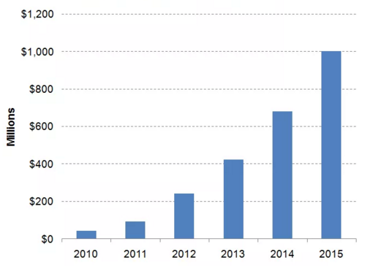
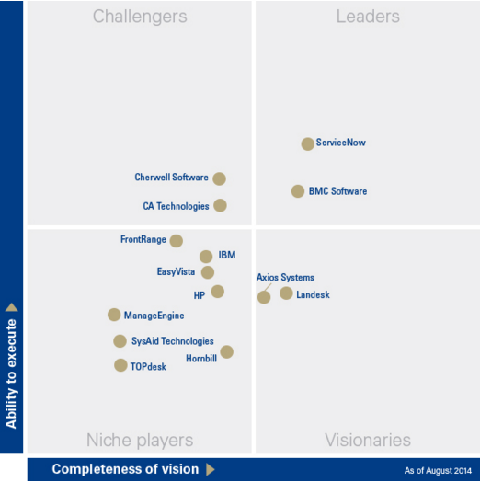
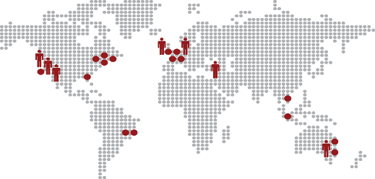
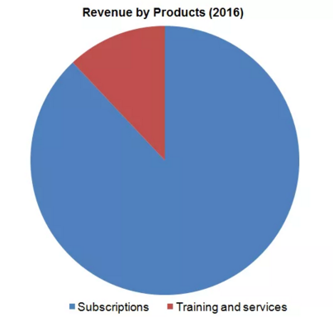
ServiceNow Details
Enterprise Cloud
NYSE: NOW
ServiceNow Revenue Over the Years
Crossed $1 Billion in Fiscal 2015
Cloud-based Service that Modernizes and Transforms the Enterprise
Highly Secure and Available Enterprise Cloud
PaaS Business Model
2,400+
Enterprise Customers
3600+
Global Employees
Major Sites
San Diego, Silicon Valley, Seattle, Amsterdam,
London, Sydney, Israel, India

Slide 27
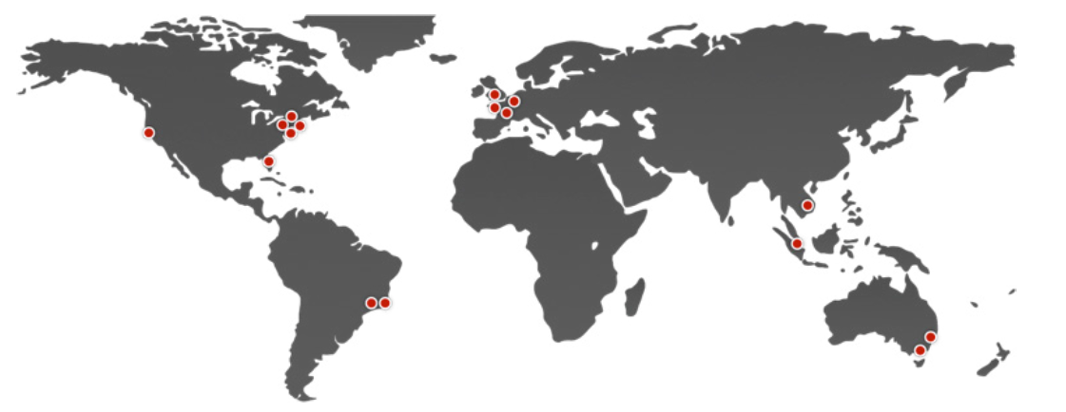
Advanced High Availability Architecture
Global Data Center Pairs
ServiceNow’s data centers are arranged in pairs. ServiceNow has 8 data center pairs (for a total of 16 data centers) across four geographic regions including Asia Pacific Japan (APJ); Europe, Middle East and Africa (EMEA); North America; and South America. Within several of these regions, there are specific country pairs for Canadian, U.S., Australian, and Swiss customers.
ServiceNow’s data centers and cloud-based infrastructure have been designed to be highly available. All servers and network devices have redundant components and multiple network paths to avoid single points
of failure.
Through ServiceNow’s unique, multi-instance architecture, Advanced High Availability meets and exceeds stringent requirements surrounding data sovereignty, availability and performance.

Slide 28
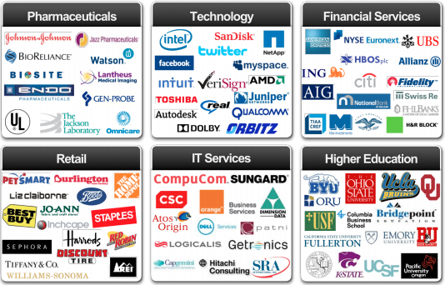
Global enterprises from all industries rely on ServiceNow

Slide 29
What ServiceNow can do
Photo by: ServiceNow

Slide 30
Enterprise Service Management - Governance
Center of Excellence (CoE)
Finance
HR
Marketing
Facilities
IT
How do we address competing business needs and priorities for one platform?

Slide 31
Use Case: Onboarding

Slide 32
The onboarding experience

Slide 33
Onboarding activities
Security
HR
Network and Telecom
Badge access to buildings
Learning and development, training, and policy acknowledgement
New hire needs to enroll in benefits
Phone numbers
Internet access
Remote access (VPN)
Voicemail
Finance
IT
Facilities
Payroll
401k
Hardware
Software
Applications access
Desk space and configuration

Slide 34
Implementation: Agile Methodology

Slide 35
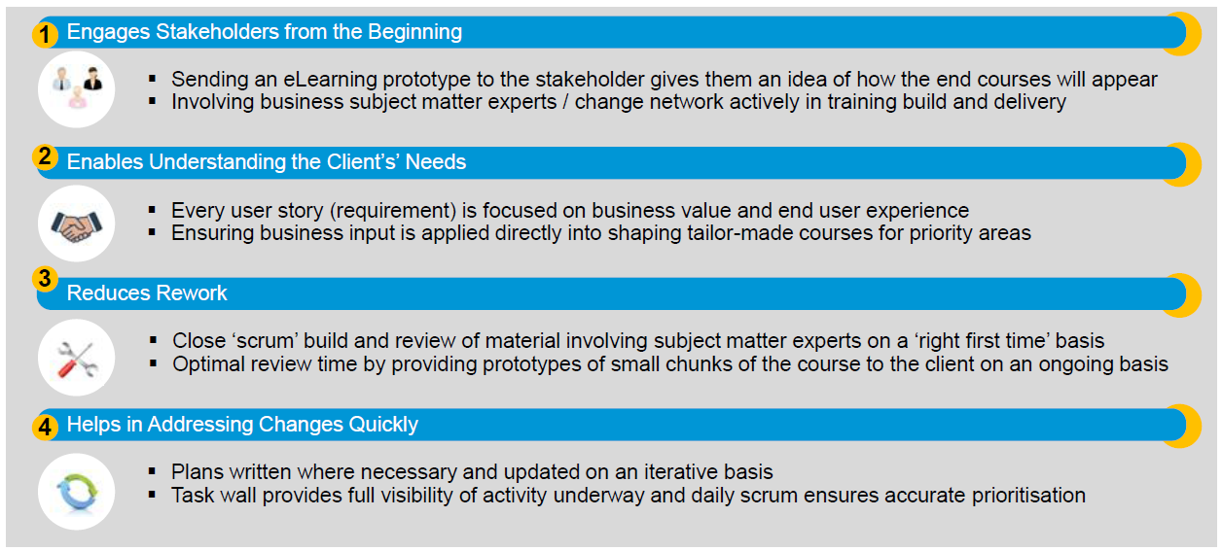
Benefits of Agile – in the Context of Training

Slide 36
Agile
There are a number of scenarios in which you may develop material using Agile:
The project is using Agile methodology therefore change management and training need to comply
The client is shifting to Agile as a methodology and needs training to follow Agile processes
You are working in a team that decides to use Agile for training material development
You want to bring elements of Agile into your development as a ‘hybrid’ approach
Agile methods and practices can also be adapted and used in any team, employing specific “elements” rather than the full approach:
Agile – development using Agile methods including sprints, scrums and retrospectives
Hybrid Agile – iterative development within a standard project release or ‘waterfall’ timeframe
Client Tailored Methods – Agile methods developed specifically by the client and often proprietary

Slide 37
Waterfall Methodology vs. Agile Methodology

Slide 38
Why Adopt Agile in Application Development?
The idea of using Agile is becoming increasingly popular, because:
Business sponsors are not able to articulate all of their needs and desires at the beginning of the project.
An Organization's underlying needs keep changing along the way and we want to be responsive—not resistant—to those changes.
Agile methods usually aim to deploy products to market faster compared to traditional methods.
Agile offers great levels of transparency and enables the team members to do what they do best: visualize a solution, engage the right people, and build a shippable product.

Slide 39
Q&A

